Slide 1
Mobile Application Development
David Drohan (ddrohan@wit.ie)

Slide 2

Coroutines in Kotlin

Slide 3
Agenda
Background
Introduction
The Terminology
Sample Code
Case Study

Slide 4
Agenda
Background
Introduction
The Terminology
Sample Code
Case Study

Slide 5

Sample Code

Slide 6
Recap / Intro
coroutines are (more or less) light-weight threads. They are launched with launch (a coroutine builder) in a context of some CoroutineScope.
In the next few examples we are launching new coroutines in the GlobalScope, meaning that the lifetime of the new coroutine is limited only by the lifetime of the whole application.

Slide 7
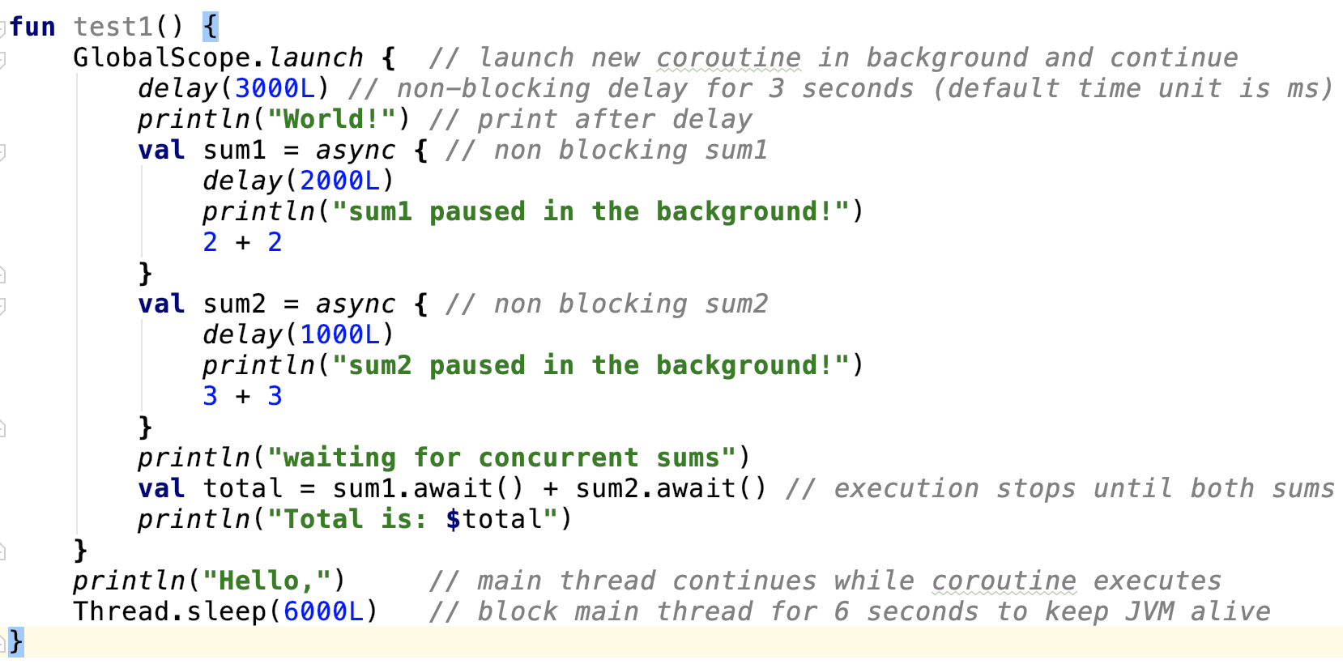
Notes:
CoroutineBuilders: These take a suspending lambda as an argument to create a coroutine. There are a bunch of coroutine builders provided by Kotlin Coroutines, including async(), launch(), runBlocking.

Slide 8
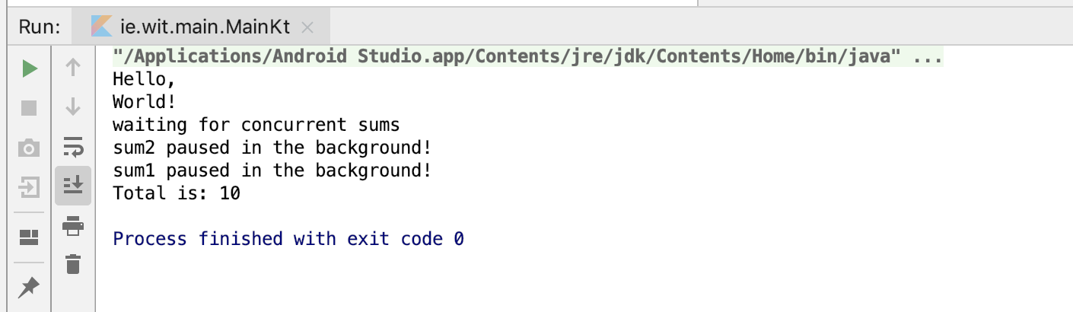
Output of ‘test1’
Notes:
We’ll see this in action later (and all the rest)

Slide 9
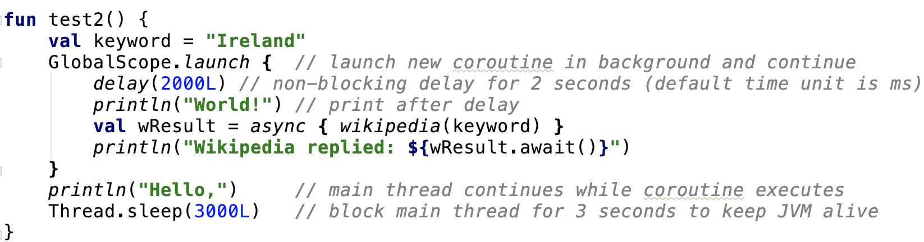
Notes:
CoroutineBuilders: These take a suspending lambda as an argument to create a coroutine. There are a bunch of coroutine builders provided by Kotlin Coroutines, including async(), launch(), runBlocking.
We’ll have a quick look at the Wikipedia function later

Slide 10
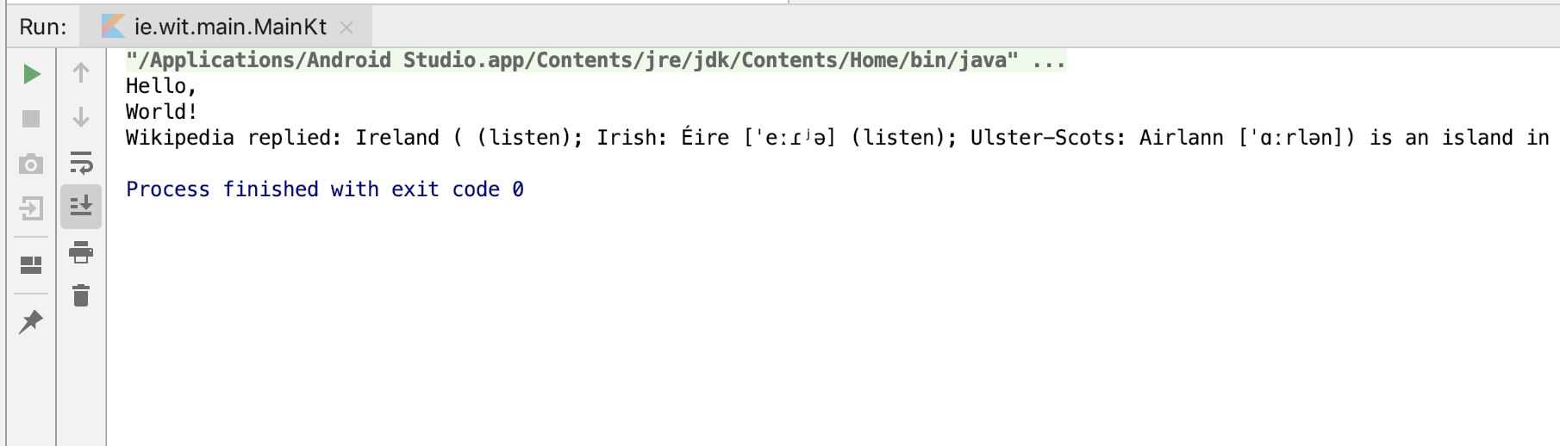
Output of ‘test2’

Slide 11
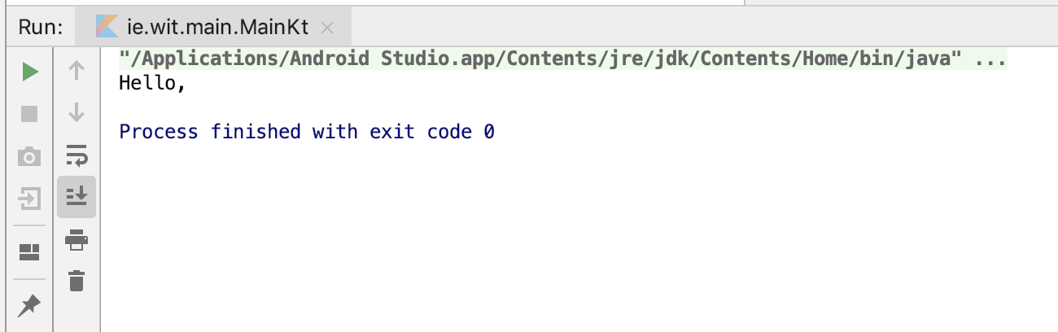
Output of ‘test2’ ( with Thread.sleep(2000L) )
Notes:
The coroutine in the background is still running when the main app dies (after 2 seconds) so it just dies too

Slide 12
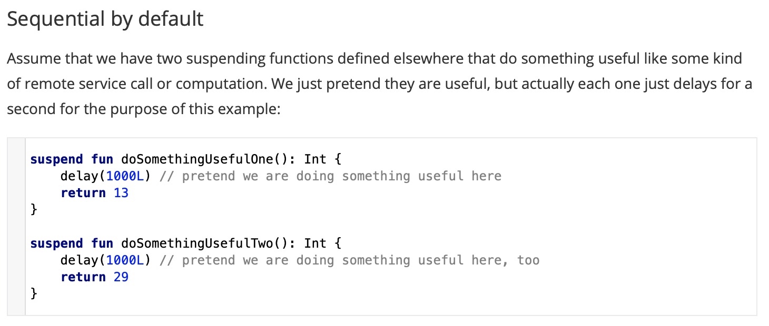
Writing Suspending Functions
Notes:
What do we do if we need them to be invoked sequentially — first doSomethingUsefulOne and thendoSomethingUsefulTwo, and compute the sum of their results?
In practice we do this if we use the result of the first function to make a decision on whether we need to invoke the second one or to decide on how to invoke it.

Slide 13
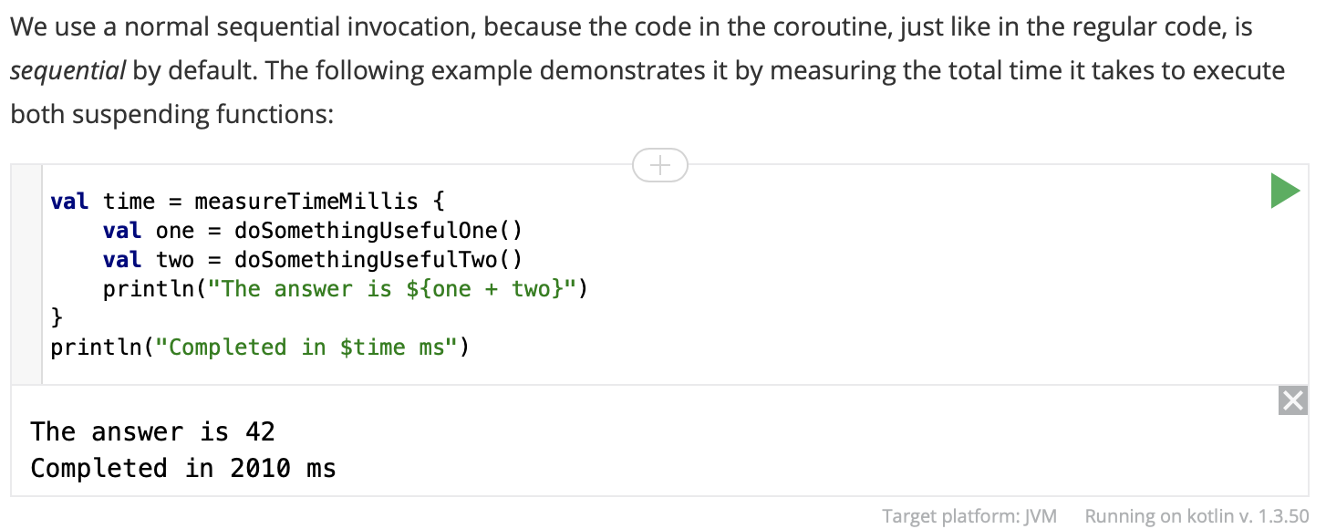
Writing Suspending Functions

Slide 14
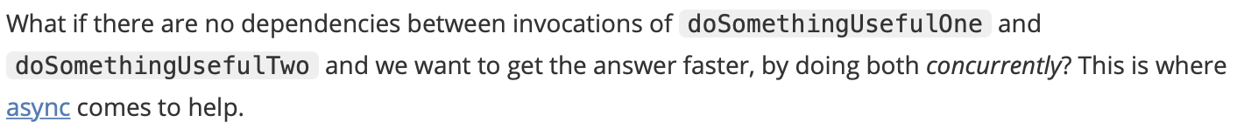
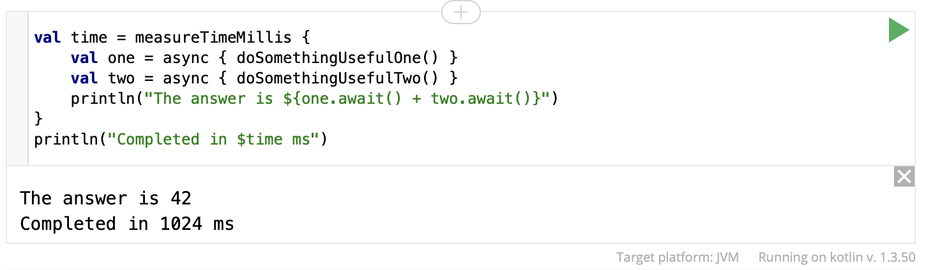
Writing Suspending Functions
Notes:
This is nearly twice as fast, because the two coroutines execute concurrently. Note that concurrency with coroutines is always explicit

Slide 15
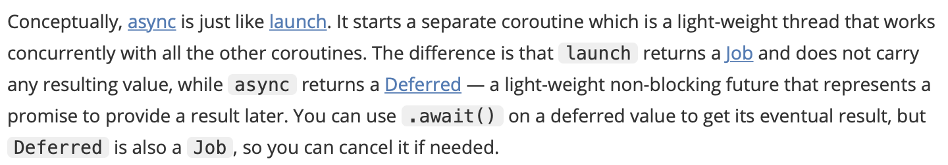
Writing Suspending Functions

Slide 16
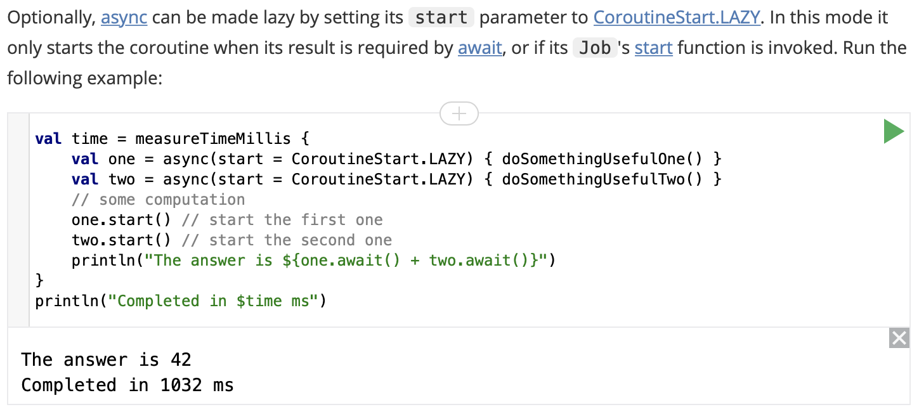
Writing Suspending Functions

Slide 17
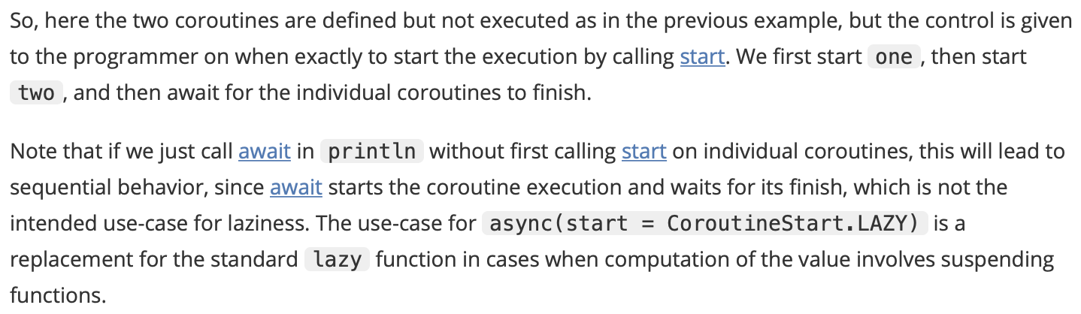
Writing Suspending Functions

Slide 18
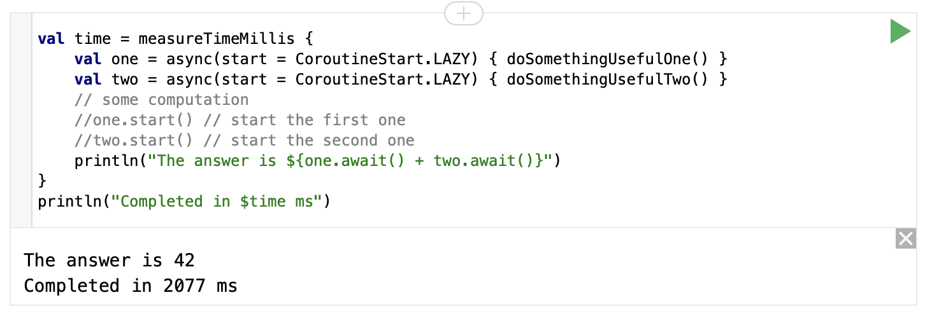
Writing Suspending Functions

Slide 19
Case Study - Snowy

Slide 20
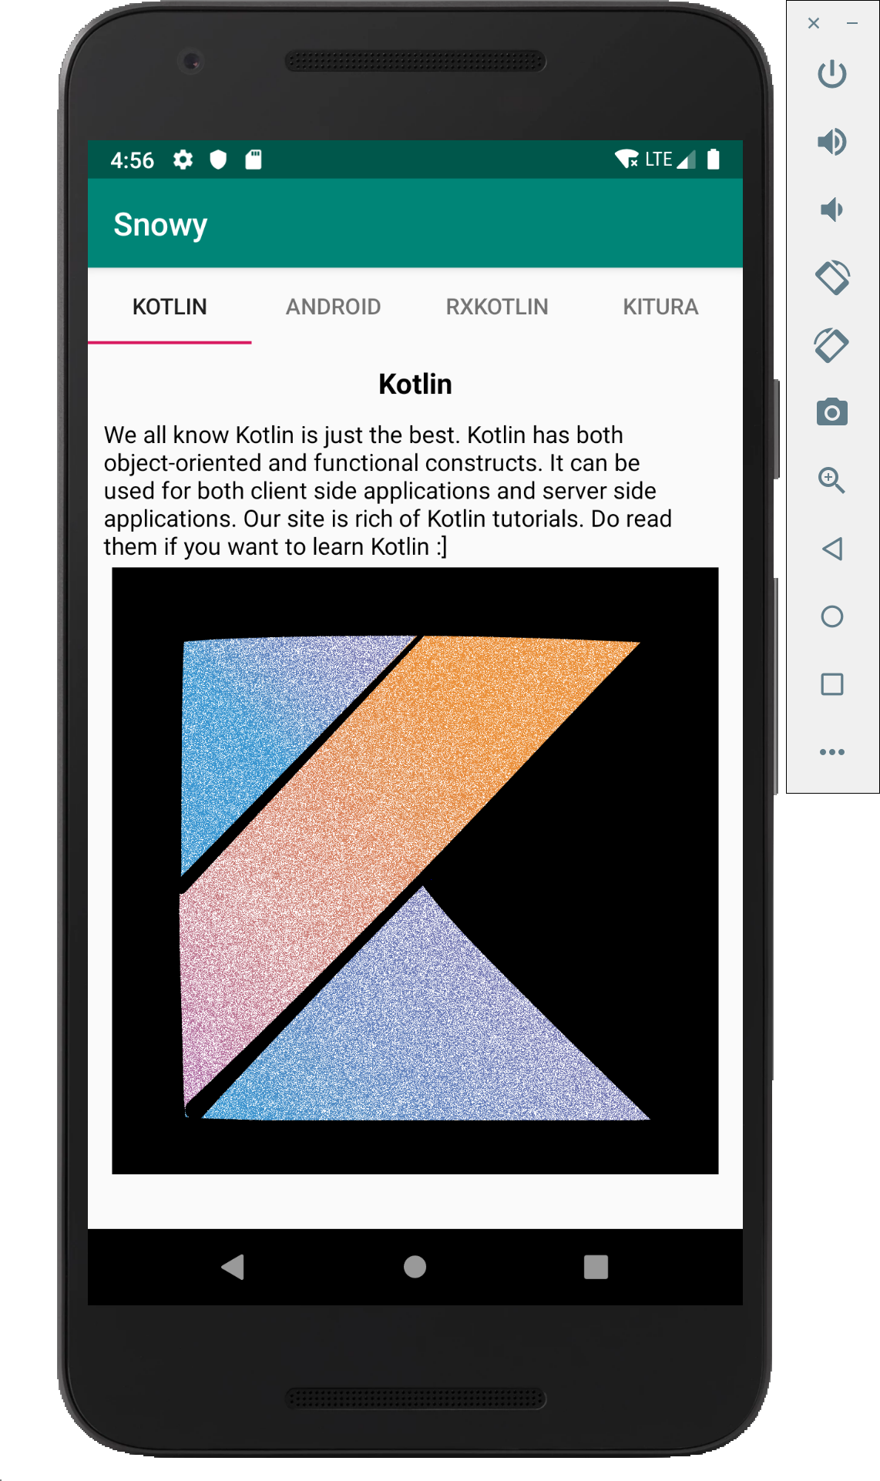
What is Snowy?
Snowy is a photo editing app, which will allow you to download an image and then apply a snow filter to that image.
To download the images, and process them, you’ll need to perform asynchronous tasks.

Slide 21
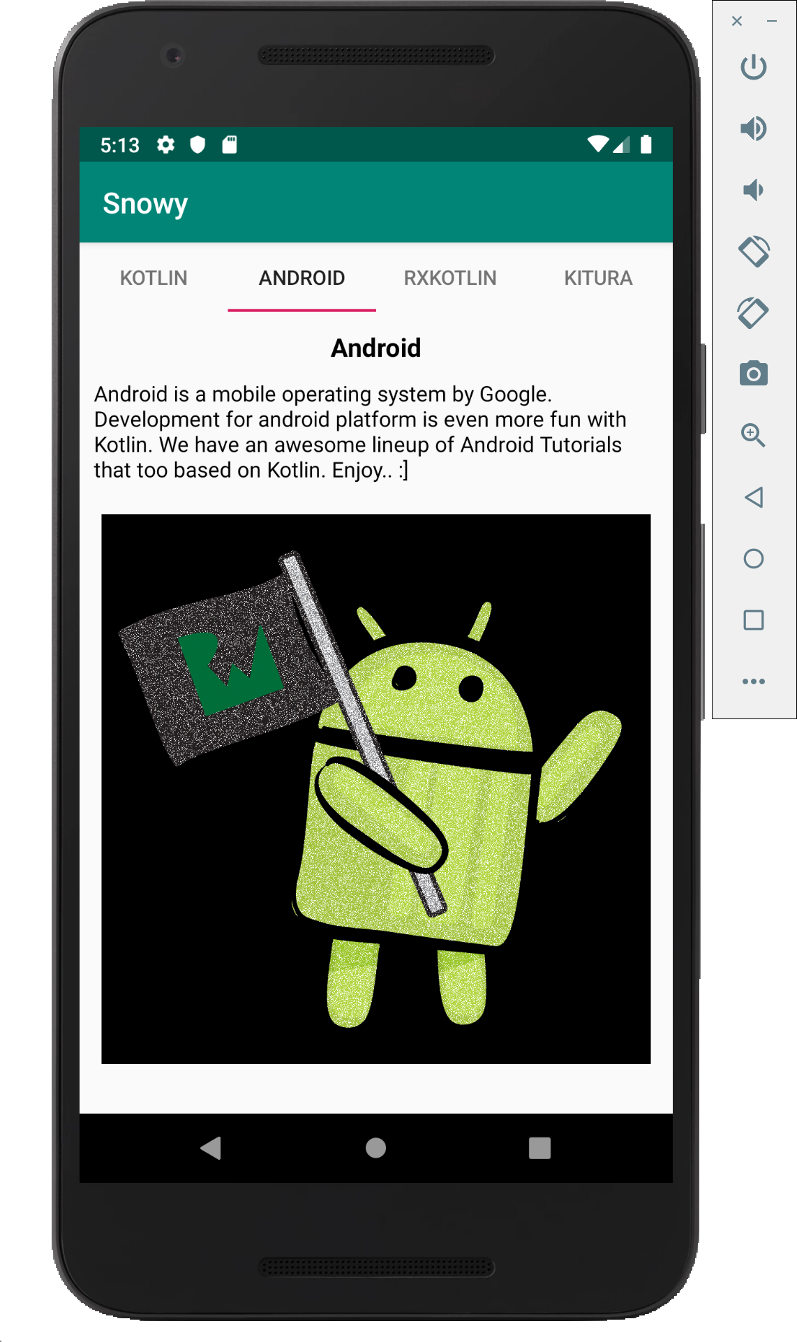
What is Snowy?
Snowy is a photo editing app, which will allow you to download an image and then apply a snow filter to that image.
To download the images, and process them, you’ll need to perform asynchronous tasks.

Slide 22
References
Sources: https://antonis.me/2018/12/12/an-introduction-to-kotlin-coroutines/ https://github.com/antonis/CoroutinesExamples https://proandroiddev.com/kotlin-coroutines-channels-csp-android-db441400965f
https://superkotlin.com/coroutines/
https://www.codementor.io/jimmy_chuks/introduction-to-coroutines-xr674rfpo
https://www.raywenderlich.com/1423941-kotlin-coroutines-tutorial-for-android-getting-started
https://android.jlelse.eu/kotlin-coroutines-threads-concurrency-and-parallelism-101-78a56e09d373
https://kotlinlang.org/docs/reference/coroutines/composing-suspending-functions.html

Slide 23


